Slide 1
THE DOM AND
JQUERY
Chapter 5
Here is where your presentation begins

Slide 2
You can also use JavaScript to modify and interact with the html you write in web pages.

Slide 3
01
HOW CAN YOU DO THAT?
USING THE DOM, OR DOCUMENT OBJECT MODEL
<HTML>
<element tag> content </element tag>
</HTML>
A DOM element

Slide 4
HOW DO WE SELECT A PARTICULAR ELEMENT IN HTML?
<html>
The Dom
Tree
<head>
<body>
<title>
<h1>
<p>

Slide 5
Practical Demonstration
<html>
<head>
<title>
</title>
</head>
<body>
<h1>heading</h1>
<p>paragraph</p>
</body>
</html>

Slide 6
What is an id in HTML?
What is an id in HTML?

Slide 7
Example:
<h1 id="main-heading">Hello world!</h1>
Like in school you have to wear an ID card so that you can be recognizable as a student of that school, similarly, html also has a way of recognizing it’s elements by setting an id

Slide 8
How to get the contents of the element we selected?
The innerHTML property will retrieve the text inside the selected element.
headingElement.innerHTML;
<h1 id=“main-heading”>Hello world!</h1>

Slide 9
Definition of concepts
We can now just assign a new value to our content
This will help us take input from the user
headingElement.innerHTML=newHeadingText;

Slide 10
Features of the topic
A DOM object of h1 is returned and we can store it in a variable
After searching, we can see that that the h1 element matches the id “main-heading”
var headingElement = document.getElementById("main-heading");
<p id=“para”>paragraph</p>
<h1 id=“main-heading”>Hello world!</h1>
We can use the DOM method document.getElementById
to select the required element

Slide 11
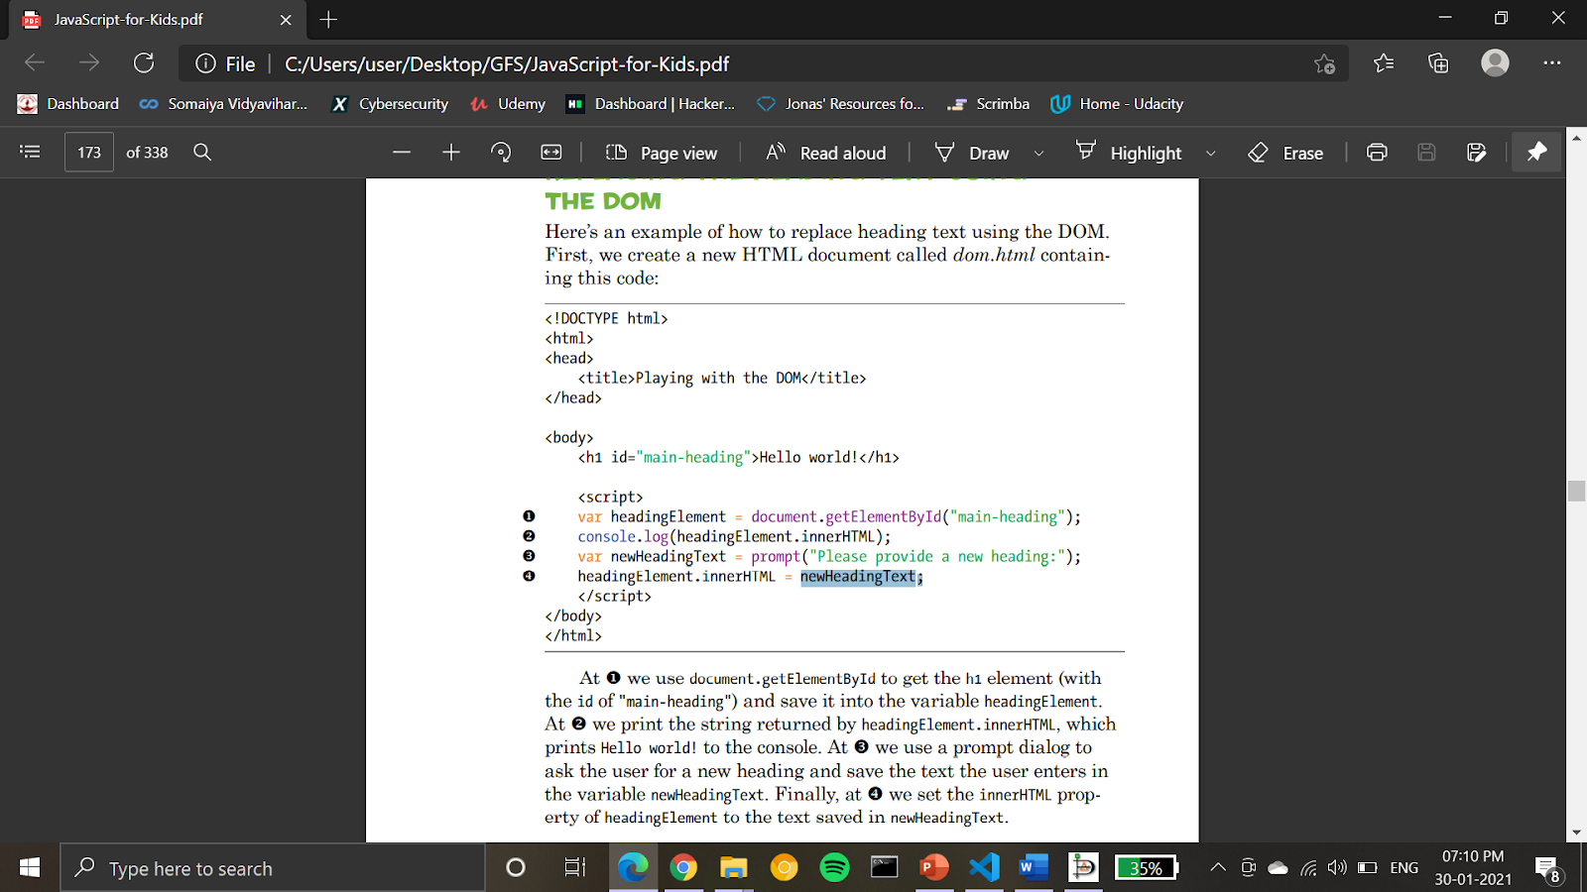

Slide 12
Thank you

